Slide 1
Smart street light monitoring system
An efficient approach for power saving

Slide 2
Introduction:
Electricity is the only resource we have to power our utilities like lights, fans, coolers, refrigerators, cars and many more..
Our pavements, streets, Highways and all roads have lights in common. They are consuming more than 40% of the city’s electricity.
So, with the help of dramatic growth in science and innovations occurring in the field of Internet of Things real-time light management became possible.

Slide 3

How a street light can be made smarter?
Internet Of Things made it possible real-time observe and control sensors, devices through the internet.
Simply by enabling Eyes to the light can make it intelligent enough to emit only the required amount of light through it.
Here, eye for the street light is Light Dependent Resistor (LDR).
Not just that! We can even control that device from the corners of the world just by connecting it to the cloud.

Slide 4
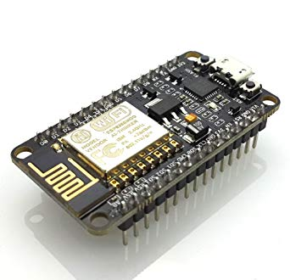
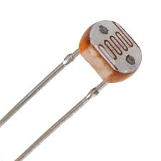
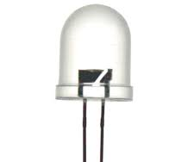
Hardware used:
NODE MCU
Light dependent resistor
LIGHT EMITTING DIOde
It is an open source IoT platform which runs on ESP8266 wi-fi SoC.
LDR is specially designed resistor that varies its resistance according to the light fallen on it.
LED is a diode which emits light as its output. This is very quick to respond to the sudden changes in the input.

Slide 5



Software used:
ARDUINO IDE
NODE-RED
MIT a2 app companion
Open-source electronic prototyping platform enabling users to create interactive electronic objects.
Node-RED is a programming tool for wiring together hardware devices, APIs and online services in new and interesting ways
It helps in developing own android apps by customizing with easy steps. It helps as the interface serving the purpose observing and controlling devices.

Slide 6
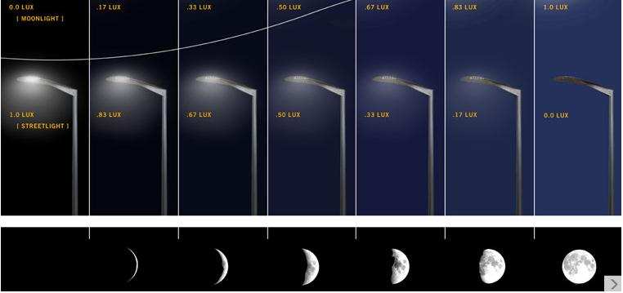
How smart street light works:
1. This project connects the physical devices like street lights embedded with Node MCU and LDR to IBM cloud services like NODE-RED.
2. Depending on the intensity of light falling on the LDR it offers equivalent resistance across the LED and lets the light glow with enough intensity.
3. When these devices are connected with internet, one can monitor its intensity and control the device anywhere from a website or app interface developed.

Slide 7
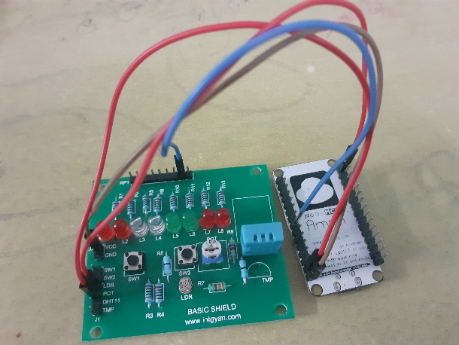
Hardware connections:
The hardware connections are made by connecting A0 pin of Node Mcu with the LDR.
Connect the LED with one of the pins ,say, D5 here.
Power the basic shield by connecting Vcc and GND pins

Slide 8
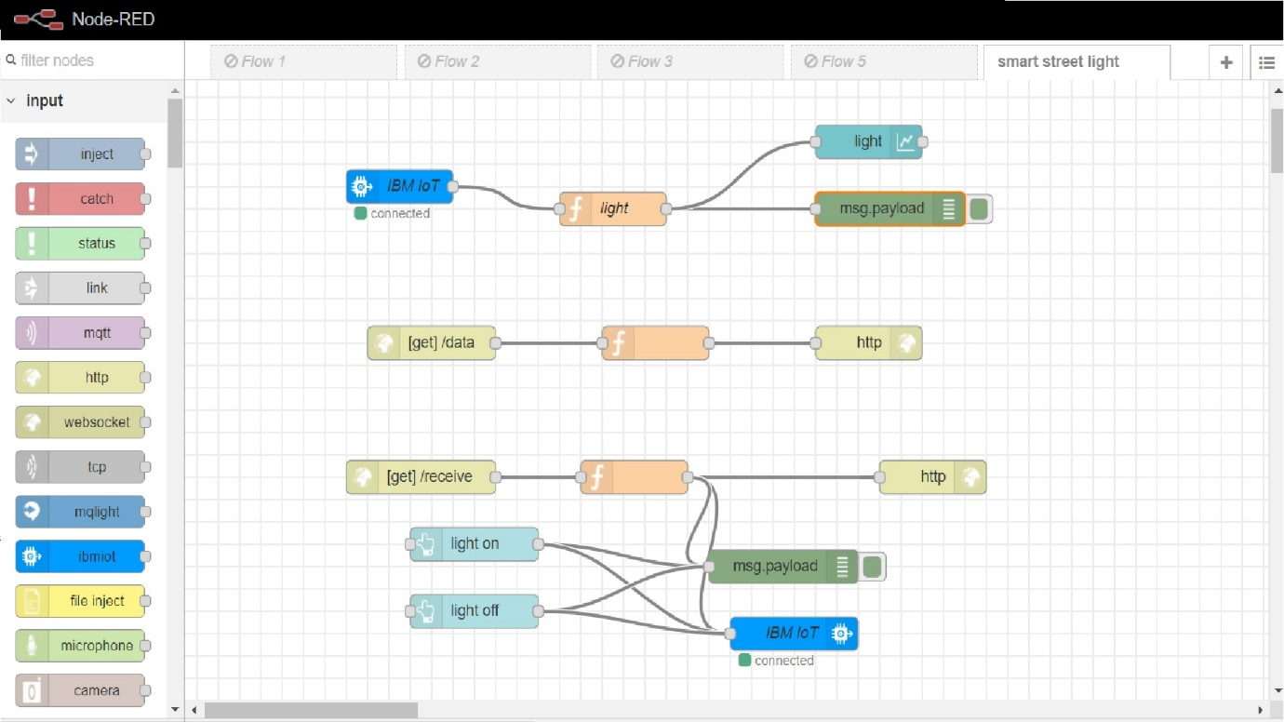
Node-red connections:

Slide 9
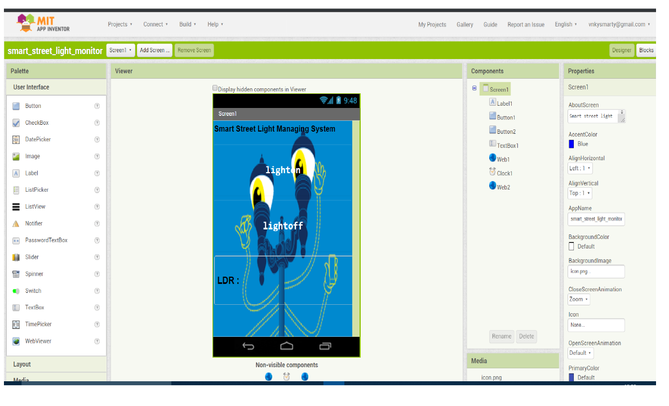
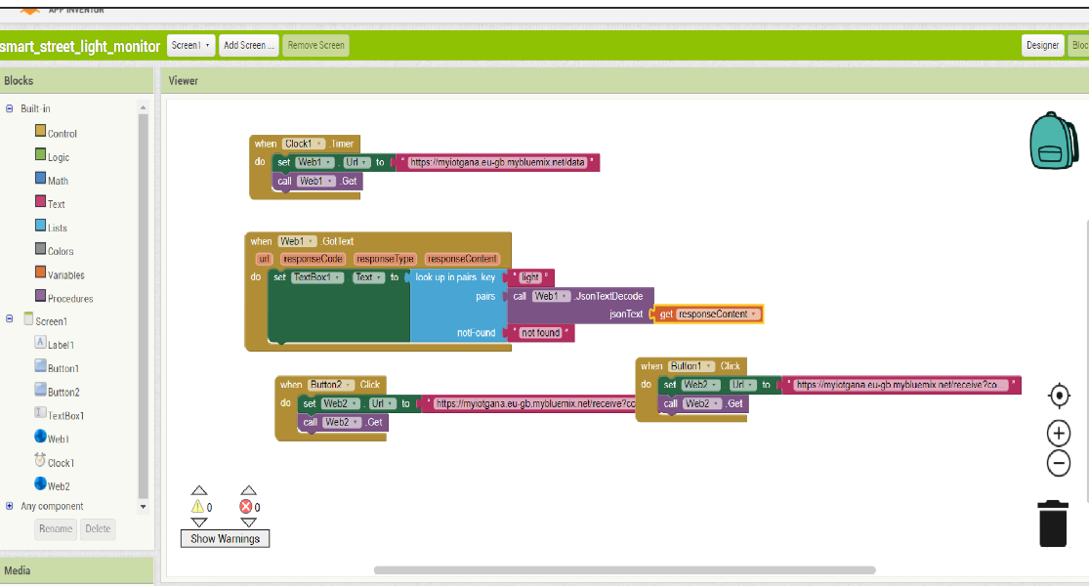
MIT A2 app interface and connections:

Slide 10
Arduino code:
The code for the project is available here in our Git hub page https://github.com/Gana1122/IoT/blob/master/Smart_Street__light_monitoring_system/Smart_Street__light_monitoring_system.ino
When the code is properly processed and altered with the owner’s credentials, upload the code to the node mcu and if the device and mobile is connected through the internet one can monitor and control from any part of the globe.

Slide 11
Future scope of the project:
We can even connect a solar panel that receives maximum light in the daylight and powers the streetlights over night. In this way we can balance the power scarcity of the planet.
This helps the government in saving both time and revenue by producing required output.
Smart homes and smart cities can also be developed by scaling the opportunities created by this.

Slide 12
Thank you

